Slide 1

Encryption

Slide 2






Encryption is a security method in which information is encoded in such a way that only authorized user can read it.
It uses encryption algorithm to generate ciphertext that can only be read if decrypted.
Encryption
Symmetric
Public Key
E.g. shift cypher
a
b
c
d
e
f
g
h
Nilesh → ojmfti
a
b
c
d
e
f
g
h
i
j
k
Stream cipher This kind of encryption is not very safe, but allows very cheap implementation and allows you to send messages of unknown length. Stream ciphers are based on XOR (exclusive OR) operations. The most known and used stream cipher algorithm is RC4, which is used in the important parts of society, like Wired Equivalent Privacy (WEP), Wi-Fi Protected Access (WPA), Secure Sockets Layer (SSL), Transport Layer Security (TLS), and many more protocols.
plain
plain
cypher
encryption
decryption
Symmetric

Slide 3


Block cipher Block ciphers are more used than stream ciphers in software products.
Block ciphers operate on fixed-size groups of bits (blocks). A common size is 64 bit.
PLAIN TEXT: HELLO WORLD
LINE1: H...L...R..
LINE2: .E.L.O.O.L.
LINE3: ..L...W...D
CIPHER TEXT: HLREL OOLLWD
Block ciphers have four ways to cipher data, which are as follows:
• Confusion: It is very complex relationships between the plaintext and the key that will prevent an attacker from determining the key altering the plain text
• Diffusion: This is a way to change the cipher text in multiple places every time the plain text is altered in a single place
• Substitution: This puts a different sign in place of the real one, such as substitution of a letter with another one
• Transposition: This scrambles the text, reordering it in a definite way, as in the rail fence cipher
DES
3DES
AES

Slide 4
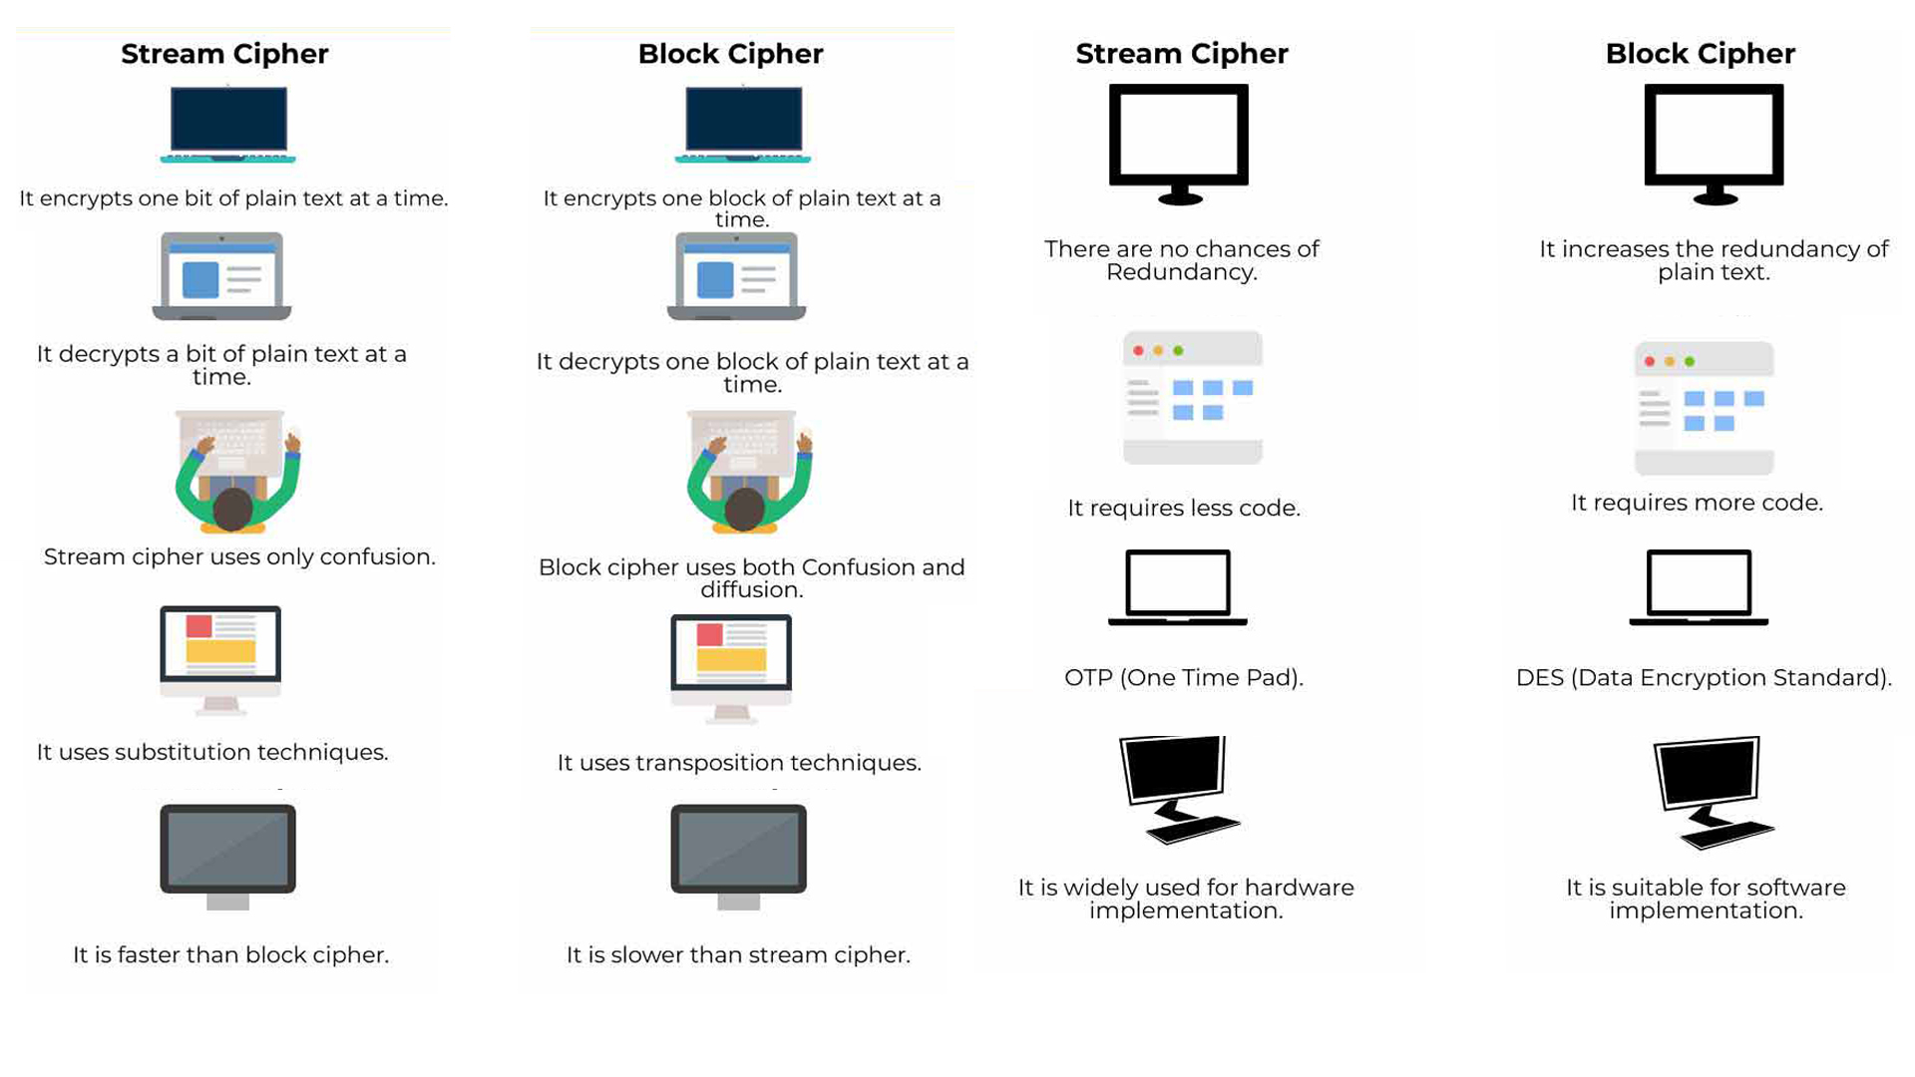



Slide 5





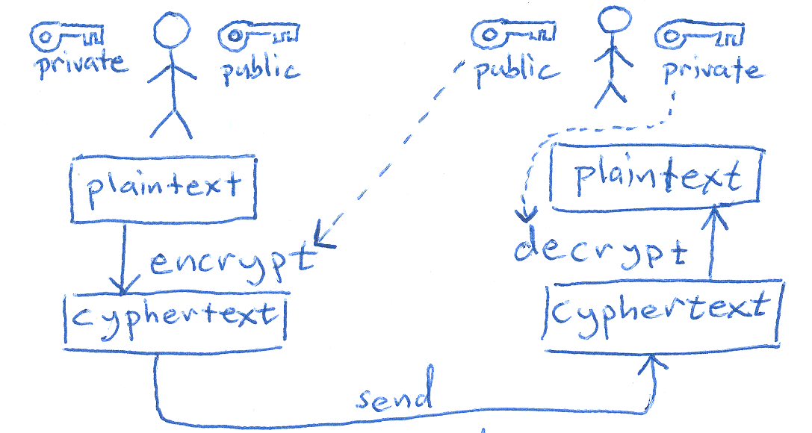






Asymmetric
AMY
RIO
Public
PUBLIC
PRIVATE

Slide 6



plain
plain
cypher
asymmetric encryption there are two keys: one public key to encrypt and a private key to decrypt. From this concept, one of the names of asymmetric encryption is derived: public key encryption
encryption
Different key use for
Encryption & Decryption
decryption
Public
Private
message
Asymmetric
&
Digital Signature
message
message
Create signature
Verify signature
asymmetric encryption allows you to sign messages, encrypting them with your private key, so that anyone with your private key can decrypt the message, understanding that it is coming from you and granting non-repudiation.
Different key use for
Encryption & Decryption
Public
Private

Slide 7
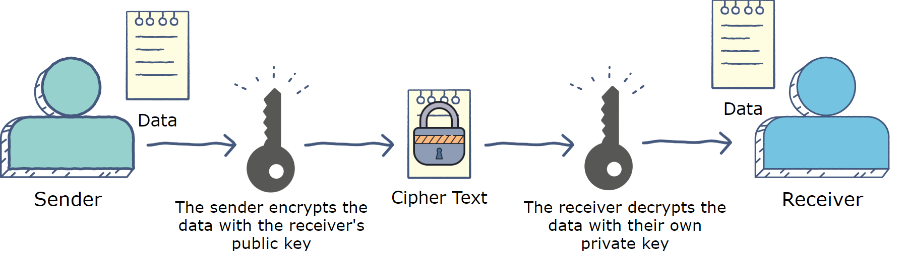
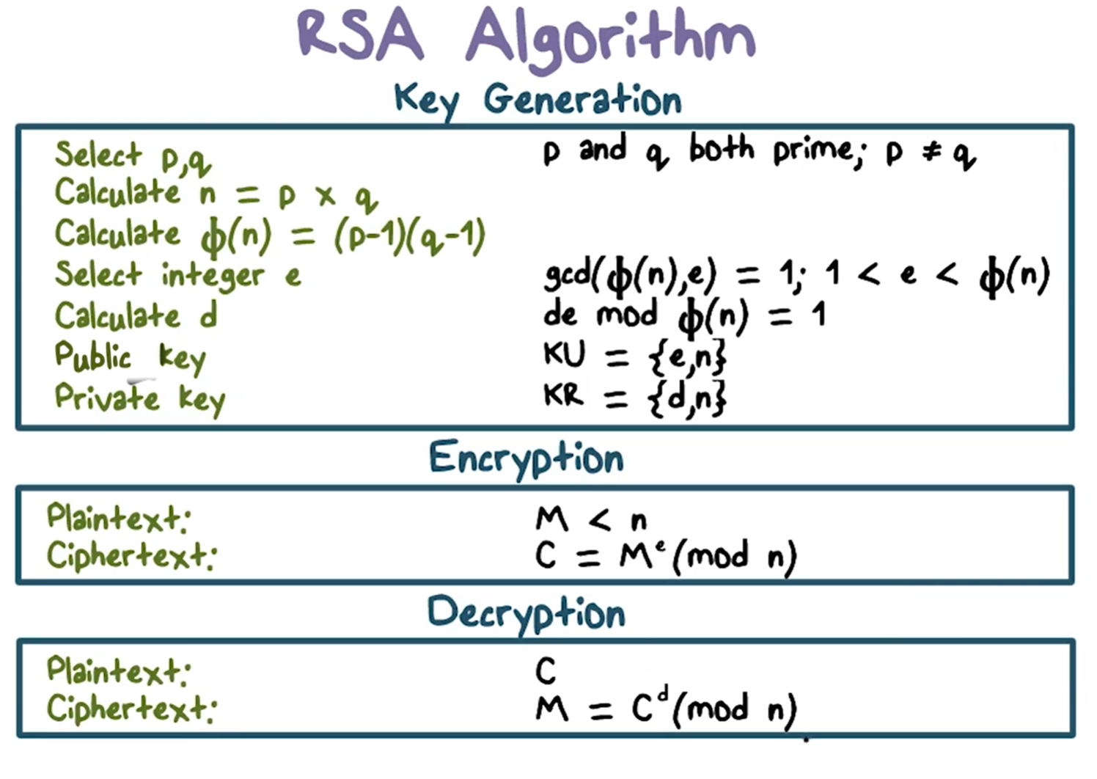
Ron Rivest, Adi Shamir, and Leonard Adleman released a new algorithm for asymmetric encryption, the RSA, a name that has been derived from their initials.
RSA supports keys up to 4096 bits, and its security is based on the idea that it is hard to find the two factors that have been multiplied only knowing the result of the multiplication. This problem is also known as prime factorization problem.
The real challenge for RSA is the randomness of the numbers necessary to create the key pair. In fact, if the numbers are not truly random, the whole algorithm could be insecure.
Due to the simplicity of the RSA algorithm, the complexity of the prime factorization problem, and the fact that the RSA patent expired in 2000, today RSA is the de facto standard for asymmetric encryption.

Slide 8
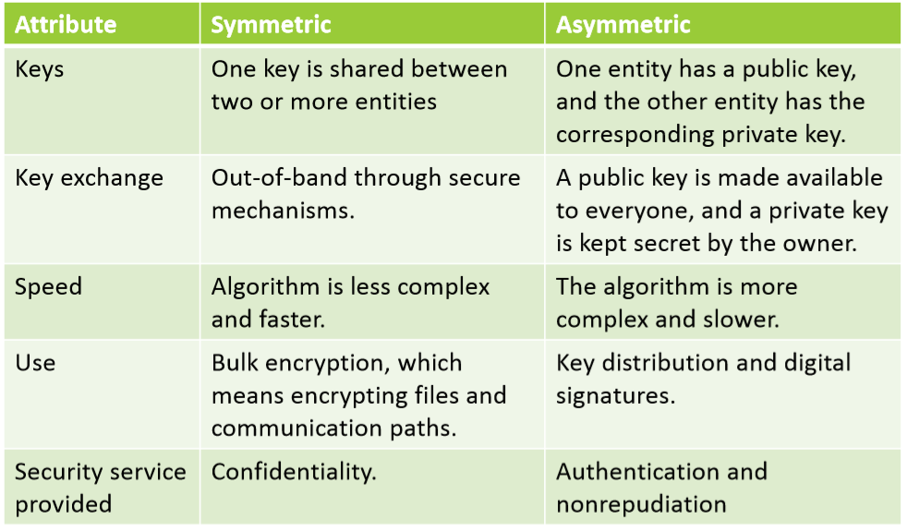

Slide 9
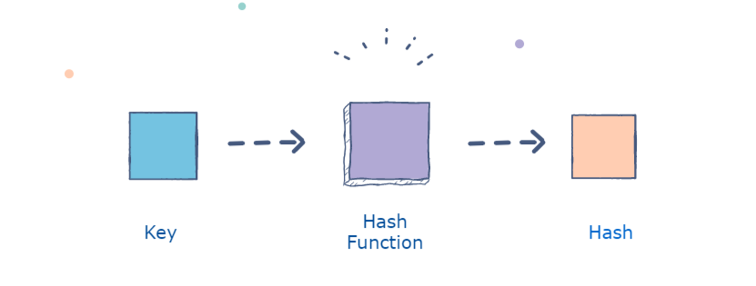
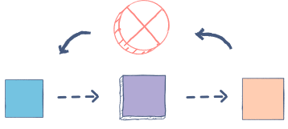
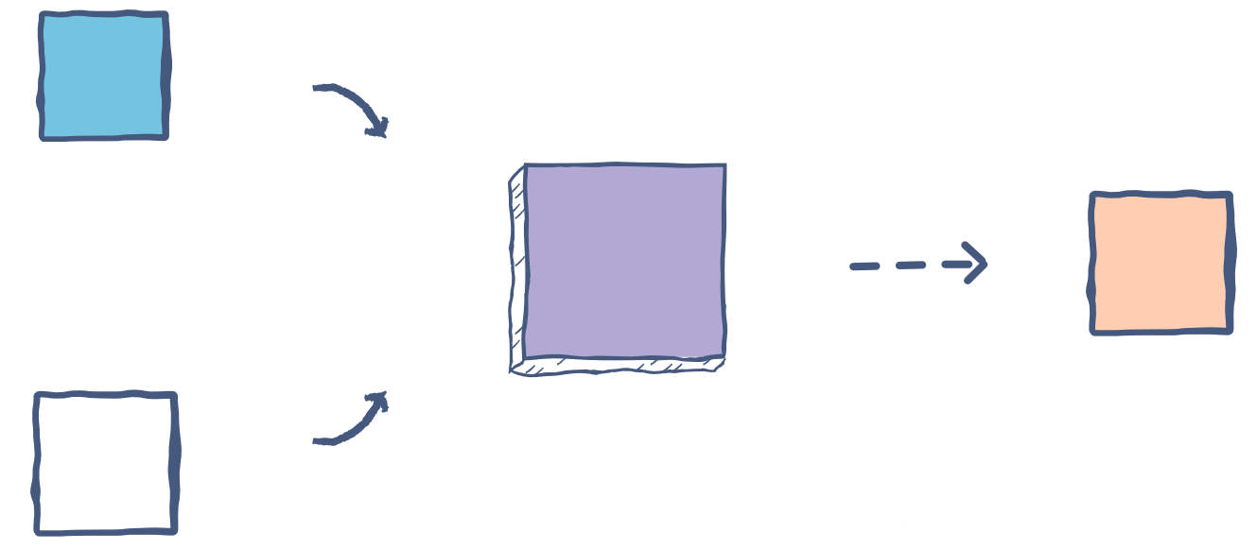
Hashing
A good hash function uses a one-way hashing algorithm, or in other words, the hash cannot be converted back into the original key.
Hashing is the process of converting a given key into another value. A hash function is used to generate the new value according to a mathematical algorithm. The result of a hash function is known as a hash value or simply, a hash.
mathematical function that condenses data to a fixed size
Hashing is about integrity and authentication.
Hashing algorithms reduce any amount of data to a fixed length value known as the hash value.
This hash value is a sort of fingerprint of the initial data.
Due to the algorithms used to create hash values, even small changes in the initial data will create huge changes in the hash value. This makes it harder to guess the initial data with a trial-and-error approach.
Keep in mind that two keys can generate the same hash. This phenomenon is known as a collision. There are several ways to handle collisions, but that’s a topic for another time.

Slide 10
MD5
MD5 Mgs.
Digest
MD5 is the most famous MD hashing algorithm and is one of the best-known of all hashing algorithms. It produces a 128-bit output (32 characters), processing the initial data in 512-bit blocks.
You can use md5sum to see the MD5 hash value of a string in the following command:
$ echo "password" | md5sum 286755fad04869ca523320acce0dc6a4
Algorithm process data in 51-bit blocks
Broken down into
16 word
Compressed
32-bit each
Outout
128-bit digest value each

Slide 11
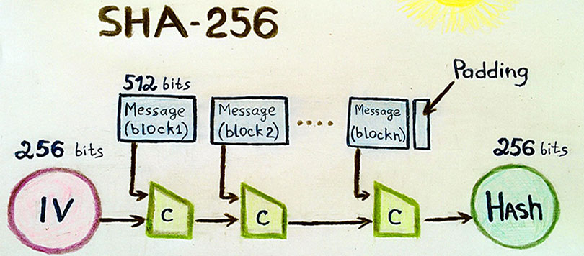
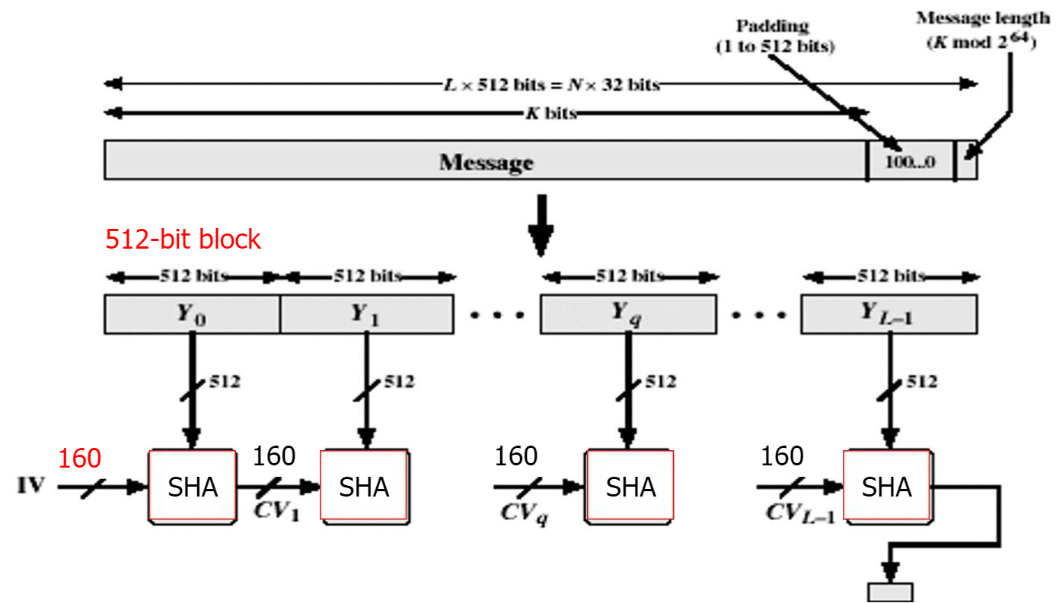
SHA
The Secure Hash Algorithm (SHA) is another series of algorithms like MD5.
The various algorithms that constitute the SHA series are:
• SHA-0: This is the first version of SHA and was withdrawn shortly after publication since a significant flaw was identified in the hashing algorithm itself.
• SHA-1: This produces 160-bit output (40 characters), and today it is considered at risk of breaking since it only offers 61 bits of security.
• SHA-2: This is a set of algorithms that can create outputs of 224-bit (56 characters), 256-bit (64 characters), 384-bit (96 characters), and 512-bit (128 characters). It's today considered safe since it can offer from 112 to 256 bits of security.
• SHA-3: This set of algorithms can create output like the SHA-2, but with an entirely different algorithm, which is based on the Keccak algorithm.

Slide 12
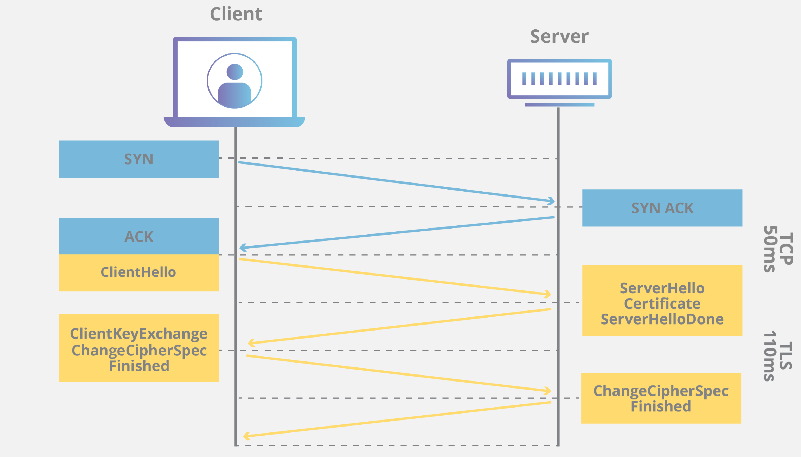
TLS
Transport Layer Security is a widely adopted security protocol designed to facilitate privacy and data security for communications over the Internet. A primary use case of TLS is encrypting the communication between web applications and servers, such as web browsers loading a website. TLS can also be used to encrypt other communications such as email, messaging, and voice over IP (VOIP).
here main components to TLS: Encryption, Authentication, and Integrity.
Encryption: hides the data being transferred from third parties.
Authentication: ensures that the parties exchanging information are who they claim to be.
Integrity: verifies that the data has not been forged or tampered with.

Slide 13
Digital signature
Digital signatures are like electronic “fingerprints.” In the form of a coded message, the digital signature securely associates a signer with a document in a recorded transaction. Digital signatures use a standard, accepted format, called Public Key Infrastructure (PKI), to provide the highest levels of security and universal acceptance. They are a specific signature technology implementation of electronic signature (eSignature).
How do digital signatures work?
Digital signatures, like handwritten signatures, are unique to each signer. Digital signature solution providers, such as DocuSign, follow a specific protocol, called PKI. PKI requires the provider to use a mathematical algorithm to generate two long numbers, called keys. One key is public, and one key is private.
When a signer electronically signs a document, the signature is created using the signer’s private key, which is always securely kept by the signer. The mathematical algorithm acts like a cipher, creating data matching the signed document, called a hash, and encrypting that data. The resulting encrypted data is the digital signature. The signature is also marked with the time that the document was signed. If the document changes after signing, the digital signature is invalidated.

Slide 14
Digital signing workflow
the signer of data, and the data recipient.
The signer creates an asymmetric key that supports digital signing.
The signer can use this key to create multiple signatures.
The signer performs a private key operation over the data to create a digital signature.
The signer provides the data and the digital signature to the data recipient.
The recipient uses the public key portion of the signer's public/private key pair to verify the digital signature. If verification is unsuccessful, then the data has been altered.

Slide 15
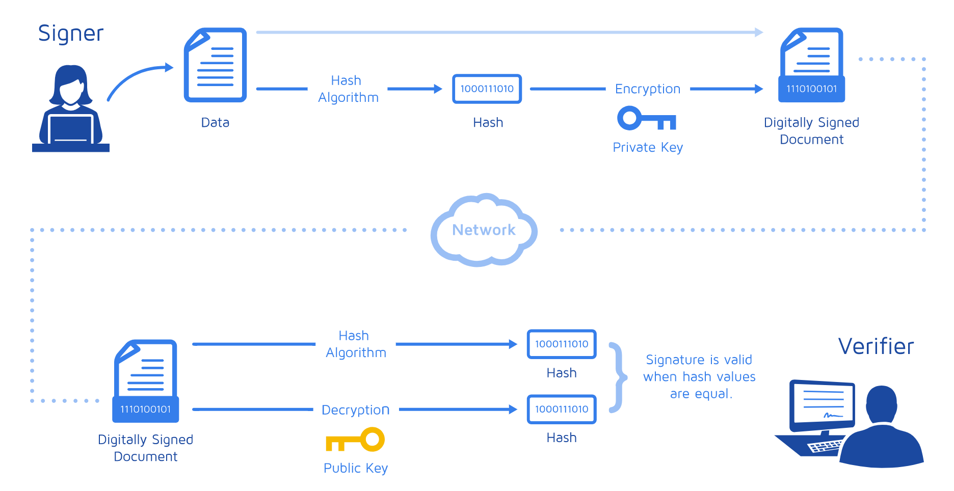

Slide 16
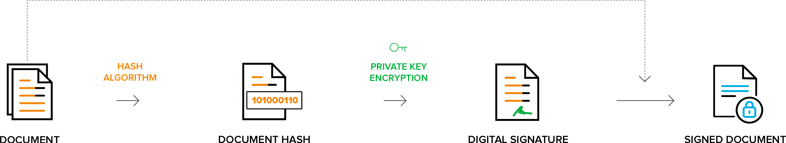
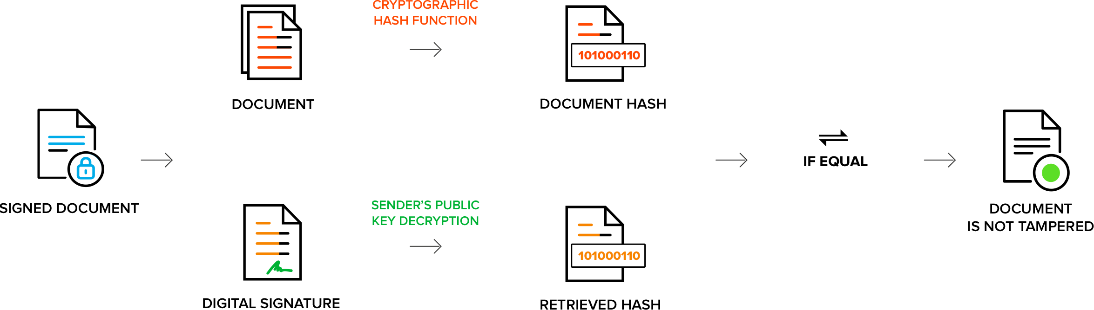

Slide 17
Cipher Suites
sets of instructions on how to secure a network through
cipher suites provide essential information on how to communicate secure data when using HTTPS, FTPS, SMTP and other network protocols. This information takes the form of algorithms and protocols that help determine how a web server secures a client’s web traffic (ssl tls).
Key Exchange Algorithm (A/symmetric )
Authentication Algorithm (RSA, DH)
Bulk Data Encryption (AES, 3DES)
Message Authentication Code (MAC) Algorithm (SHA and MD5.)

Slide 18
What does security provide?
Identification / Authentication: The persons / entities with whom we are communicating are really who they say they are.
Confidentiality: The information within the message or transaction is kept confidential. It may only be read and understood by the intended sender and receiver.
Integrity: The information within the message or transaction is not tampered accidentally or deliberately with en route without all parties involved being aware of the tampering.
Non-Repudiation: The sender cannot deny sending the message or transaction, and the receiver cannot deny receiving it.
Access Control: Access to the protected information is only realized by the intended person or entity.

Slide 19




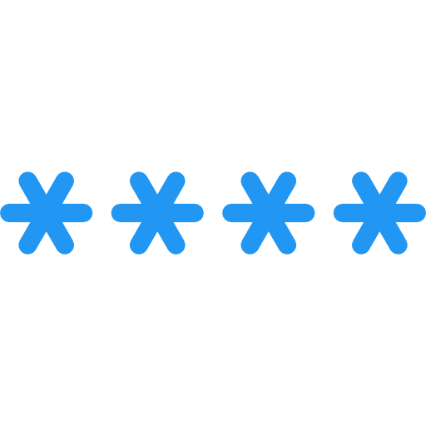


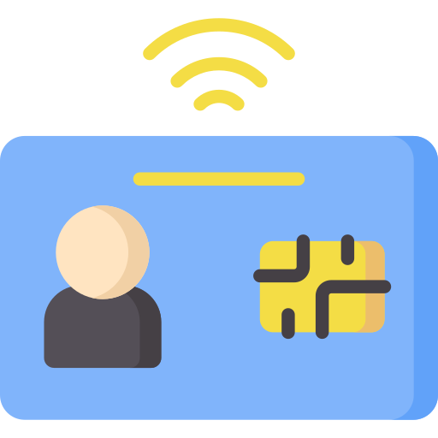

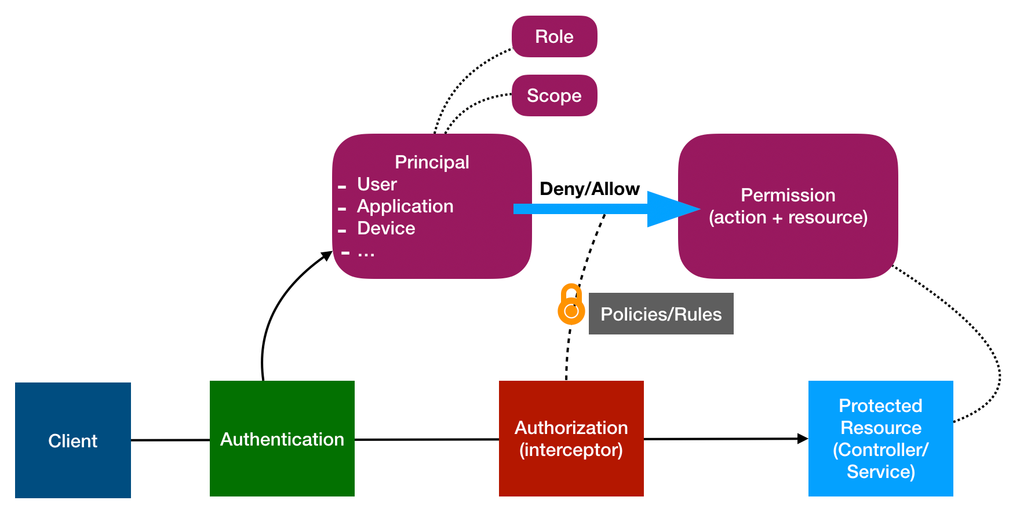

Identification: This is an action in which the user (untrusted party) declares his identity
• Authentication: This is an action(s) to prove that the user is who he claims to be
• Authorization: This action(s) is required to determine which actions a specific user can perform
Password
Proof
Access
Mandatory Access Control (MAC)
Discretionary Access Control (DAC)
Role-based Access Control (RBAC)

Slide 20
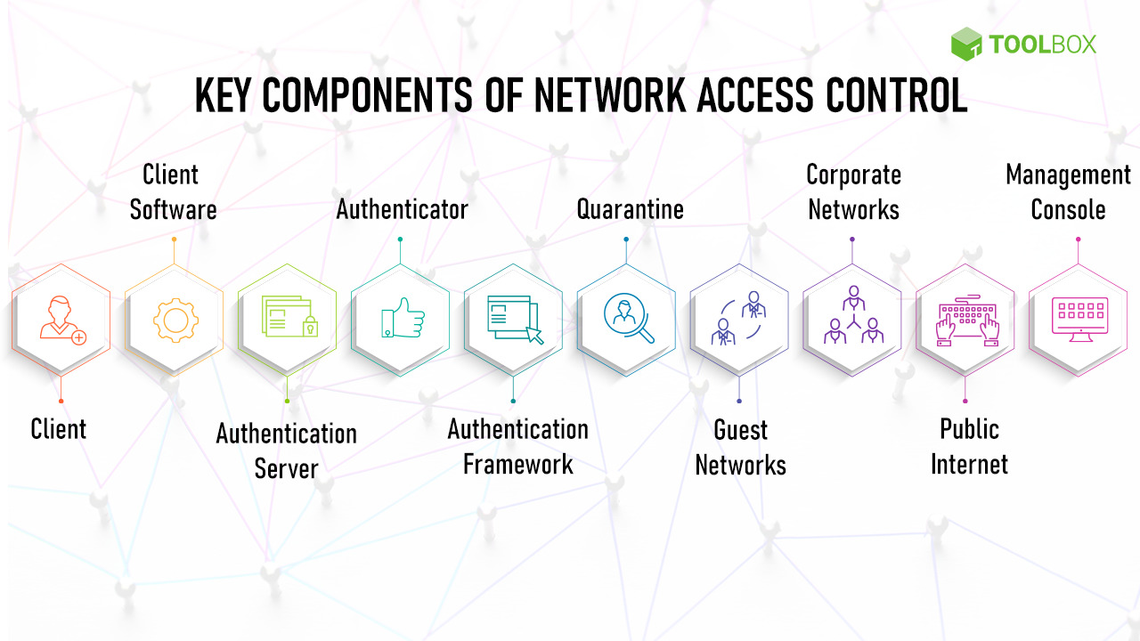

Slide 21
1. Client : Endpoint systems or the clients are one of the key components of network access control.
2. Client Software : it is a specific application or set of applications that are identified as an access gateway
3. Authentication Server : Server that validates the credentials of the client device or client software requesting access.
4. Authenticator : It comprises a managed switch or access point that securely relays credentials between components 1 or 2 and 3, ensuring that a port continues to be labeled as an unauthorized state until the authentication occurs.
5. Authentication Framework : can be considered as the language in which credentials are shared among the client device, the client software, the authentication server, and the authenticator.
6. Quarantine : Quarantine is a sandbox environment where traffic carrying non-authenticated credentials is placed, awaiting remediation.
7. Guest Network : Organizations might implement a dedicated guest network to isolate all third-party traffic.
8. Corpo. Network : This is the primary channel for communication in the enterprise, allowing authorized traffic as validated by the authentication server.
9. Public Internet : the public internet can also be used to access enterprise assets, subject to certain constraints and authentication protocols.
10 Management CONSOL : Network access control can be managed through a security dashboard hosted either on-premise or on the cloud.
11. Client Agent : to self-assess their security posture

